Slide 1
Mushrooms
Corey Haigh
Kaggle Mushroom Data Set

Slide 2
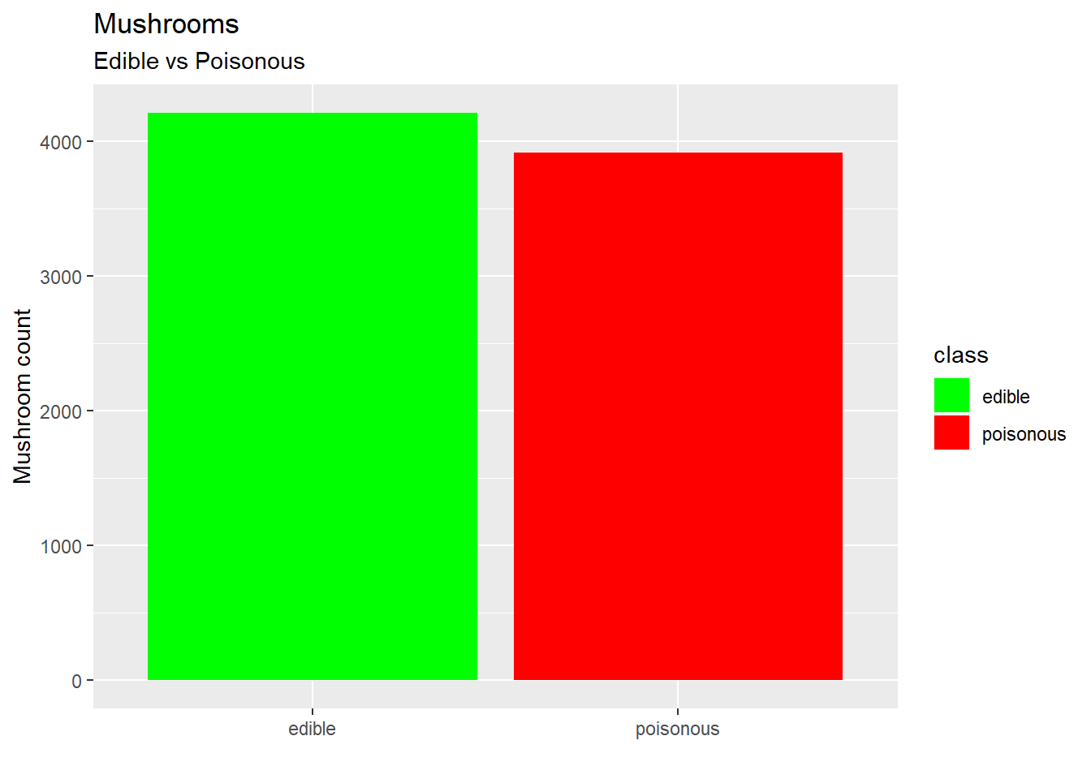
Objective
Identify easy set of rules to distinguish poisonous from edible mushrooms.

Slide 3
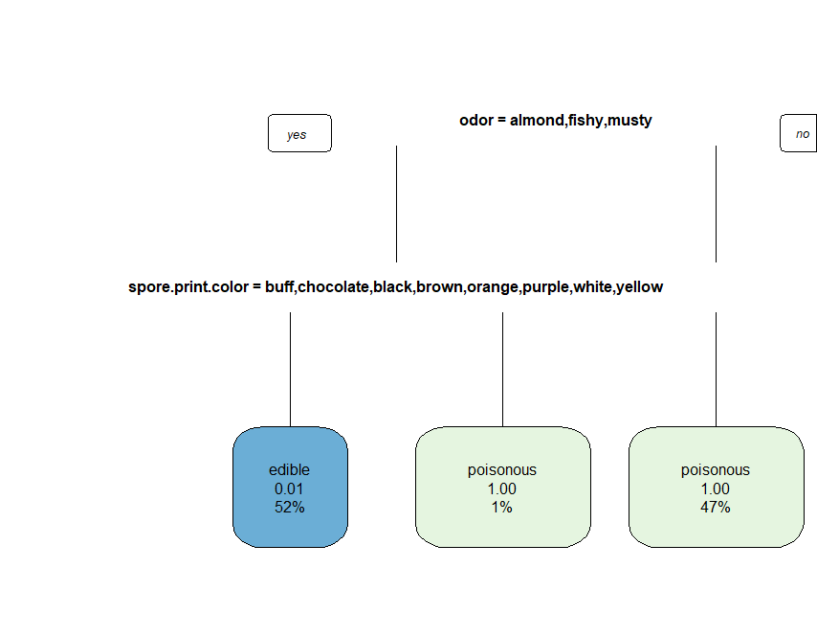
Decision Tree
By using a decision tree we are able to achieve 97.5% accuracy with a 95% CI of (.969-.981).

Slide 4
Scent
By only checking the scent of a mushroom we are able to predict whether it is poisonous or edible 98.5% of the time, with a 95% CI of (.9825-.9917).
If a mushroom smells like almond, anise, or contains no odor then it is edible.
If a mushroom smells foul, musty, pungent, spicy, creosote, or fishy then it is poisonous.

Slide 5
One Rule Accuracy Table
Smell | Predicted Correct | Predicted Wrong | Accuracy
Almond | 400 | 0 | 100%
Anise | 192 | 0 | 100%
Creosote | 2160 | 0 | 100%
Fishy | 400 | 0 | 100%
Foul | 36 | 0 | 100%
Musty | 3408 | 120 | 97%
No odor | 256 | 0 | 100%
Pungent | 576 | 0 | 100%
Spicy | 576 | 0 | 100%

Slide 6
Multiple Characteristics
By increasing the number of rules we are able to achieve 100% accuracy in classification of edible or poisonous mushrooms.
Creates too much added complexity.

Slide 7
Comparisons
Decision Tree
Scent
Multiple Characteristics
97.5% Accuracy
Moderately difficult rules to remember
98.5% Accuracy
Very easy rules to remember
100% Accuracy
Rules are extremely hard to remember

Slide 8
Conclusion
Almond, anise, and odorless mushrooms are edible.
All others are poisonous.

Slide 9
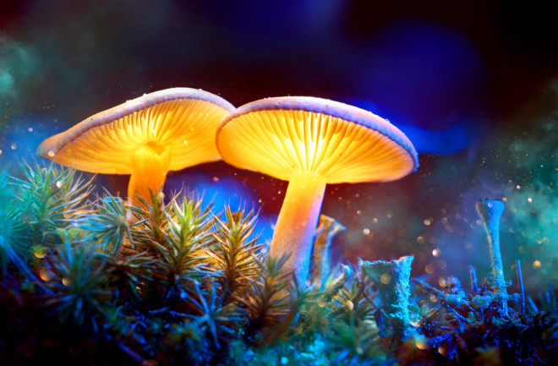
Thank You
Discover Magazine, https://www.discovermagazine.com/mind/magic-mushrooms-are-expanding-minds-and-advancing-an-emerging-field-of

